Slide 1
HTML interface
Libraries
Default app
Boot
strap
Application
Views
(html)
Angular
JS
Ampersand
model
Model
View
jQuery
Ctrls
(js)
Controller
Prototype
generator
API
Extensions
Exec
engine
Ampersand FW
Rule engine
Concept
classes
Excel
import
Installer
DB Class
DB model
Local settings
MySQL
Generics

Slide 2
HTML interface
Libraries
Default app
Boot
strap
Application
Views
(html)
Angular
JS
Ampersand
model
Model
View
jQuery
Ctrls
(js)
Controller
Prototype
generator
API
Extensions
Exec
engine
Ampersand FW
Access mngt
Trans
actions
Config
module
Concept
classes
Excel
import
Rule engine
Installer
DB Class
Logging
DB model
Local settings
MySQL
Generics

Slide 3
Rule engine
Extensions
Exec
engine
Ampersand FW
Concept
classes
Excel
import
Installer
Rule engine
DB Class
DB model
MySQL
Generics
Local settings
Drools
Oracle
??

Slide 4
Database
Extensions
Exec
engine
Ampersand FW
Concept
classes
Excel
import
Rule engine
Installer
Graph database: bv MongoDB of Neo4j
Tripple stores: bv Virtuoso
DB Class
DB model
Local settings
Graph db
Generics
Tripple store
MySQL

Slide 5
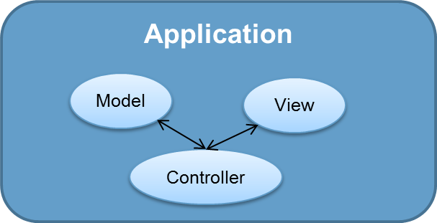
Applicatie
Common Sense
API
Extensions
Exec
engine
Ampersand FW
Rule engine
Concept
classes
Excel
import
Installer
DB Class
DB model
Local settings
MySQL
Generics

